Slide 1

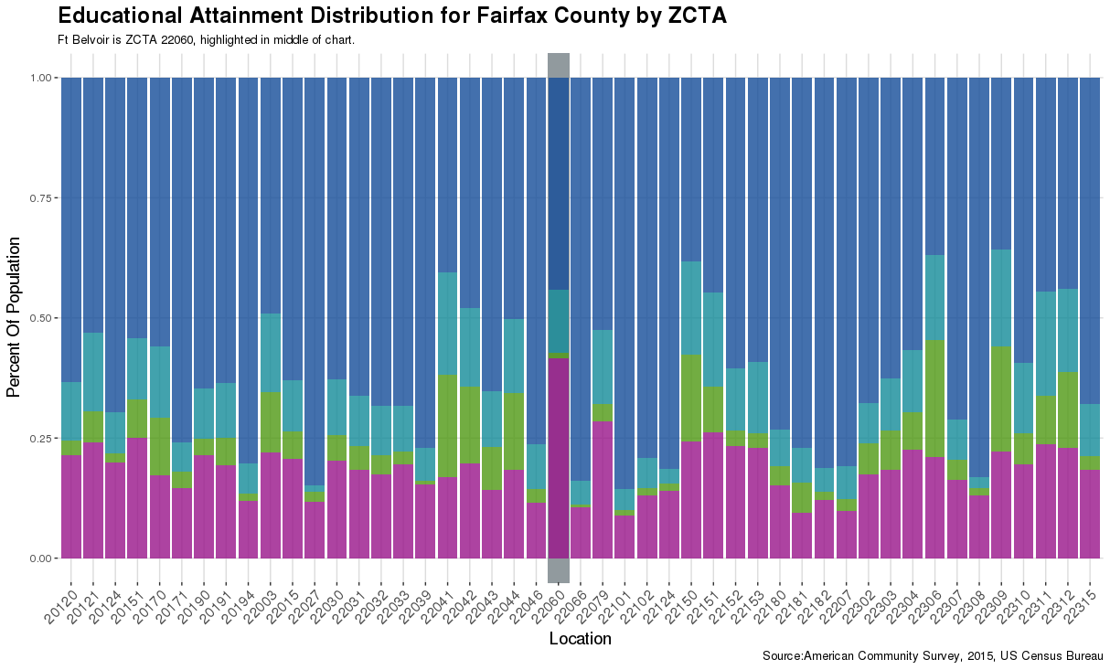
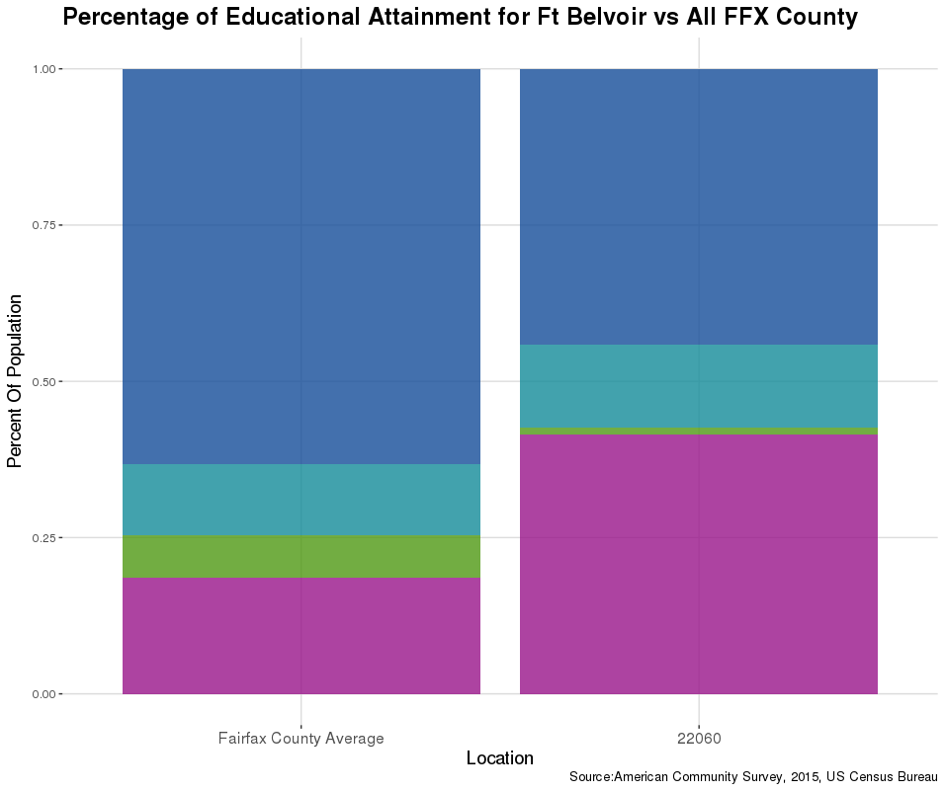
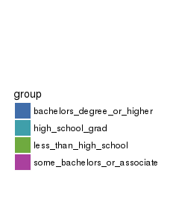
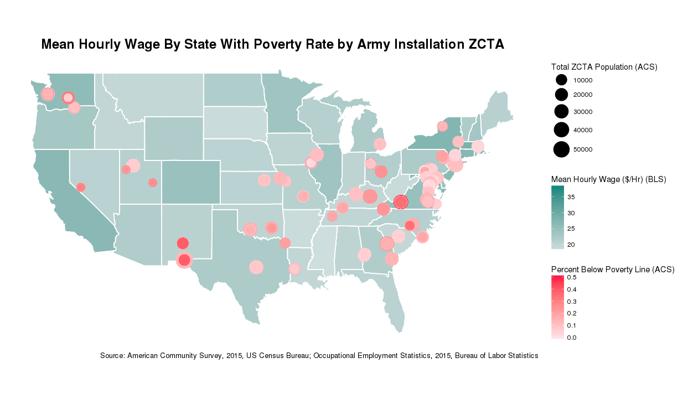

Profiling Army Installations
Zarni Htet (New York University), Adrienne Rogers (Virginia Tech),
David Hinkle (Virginia Tech), Joseph Kim (Virginia Tech), David Park (Virginia Tech)
with Joshua Goldstein and Stephanie Shipp (SDAL)
Sponsors Greg Ruark , Andrew Slaughter, US Army Research Institute for Behavioral a& Social Science Research
Project Overview
Do Soldiers leave the Army because of better opportunities in civilian life?
Project Title: Towards an Integrated Data Framework for Understanding the Context of Army Environments:
A Case Study of Attrition of Army Soldiers
Task: Identify publicly available data sources (e.g., Census and BLS data) to create social, demographic, economic, and other quantitative profiles of Army installations and their surrounding areas. Identify relevant variables for use in statistical models.
Profiling Army Installations
Purpose
Identify which social, demographic and economic variables are of interest for modeling characteristics of Army Installations that might account for attrition at these installations.
Universe: Army Installations across the 50 United States and territories.
Goal: Collect data from publicly available data sources that explain social, demographic and economic characteristics of installations.
U.S Census Bureau, American Community Survey (ACS): Gathered all tables of interest from ACS. Pulled military and demographic variables for future use
Bureau of Labor Statistics (BLS): Gathered relevant BLS data and also wrote a brief description of each survey
Installation Names / ZIP Codes: Manually compiled a list to match zip codes and their installations.
Data:
ACS (American Community Survey) | BLS (Bureau of Labor Statistics)
Geographic Level: ZIP Code Tabulated Area Intention: Demographic Analysis Targeted Variables: Educational Attainment, Children Under 18, Poverty Line Status, Transportation to Work, Marital Status, Sex, Race, Ethnicity, Government Assistance, Veteran Status, Employment Status | Geographic Level: State Intention: Employment Analysis and Identification of Economic Opportunities Targeted Datasets: Job Openings and Labor Turnover Survey (JOLTS), Occupational Employment Statistics(OES), Current Employment Statistics (CES), Current Population Survey (CPS)
Comparative Analysis: example - Fort Belvoir, Virginia located in Fairfax County, Virginia
Assess the demographic characteristics of geographic installation location in comparison to the community surrounding it.
Includes two plots:
  One compares ZCTAs associated with installation and all other ZCTAs in surrounding county (to the left)
  One compared ZCTAs associated with installation and aggregated surrounding county average (below)
Goal: Used visual analysis to look for trends in variables
Collect Zip Codes and convert to ZCTAs
  ZIP Code v. ZIP code Tabulated Area (ZCTA)
    ZIP Codes are USPS delivery areas - good for future linkage to Army’s Person Data Environment (PDE) data enclave but leads to over counting in analysis.
    ZCTAs are defined to stay in county lines and determined by population.
Gather data from ACS: Create Zip Matcher function
Create and automate plots for Comparative Analysis
Format output into easy to read HTML documents, using R Markdown
Geographic Analysis:
To understand the state level BLS data, variables are plotted across the country. ACS data is plotted by ZIP Code Tabulated Area
The BLS data includes state-level variables such as:
  Mean Wages, Mean Salaries, Counts of Government Employees (OES-Occupational Employment Survey)
  Layoffs/Discharge Rates, Quit Rates (JOLTS-Job Openings and Labor Turnover Survey)
  Duration of Employment, Discouraged Workers, Multiple Job Holders (CPS-Current Population Survey)
  Hours Worked By Government Employees (CES – Current Employment Survey)
Goal: Allow for comparative analysis across multiple installations in a user friendly platform
Perform Geographic Analysis for Census and BLS state-level data
Create user friendly, interactive Dashboard
for analysis using RShiny and Leaflet
  Display Army installations across map of United States
  Size points for installations by population
  Color points for installations by ACS variables
  Import Exploratory Analysis comparative graphs
Conclusions and Future Work
Variables of Interest for Model:
Control for demographic variables across geographic regions
Identify economic & workforce variables to evaluate opportunity cost of staying in or leaving the Army
Next Steps:
Import dataset into Army’s Person Data Environment (PDE) data enclave. Data to be publicly available to researchers in PDE and incorporate into survival model of Army Attrition

